Slide 1

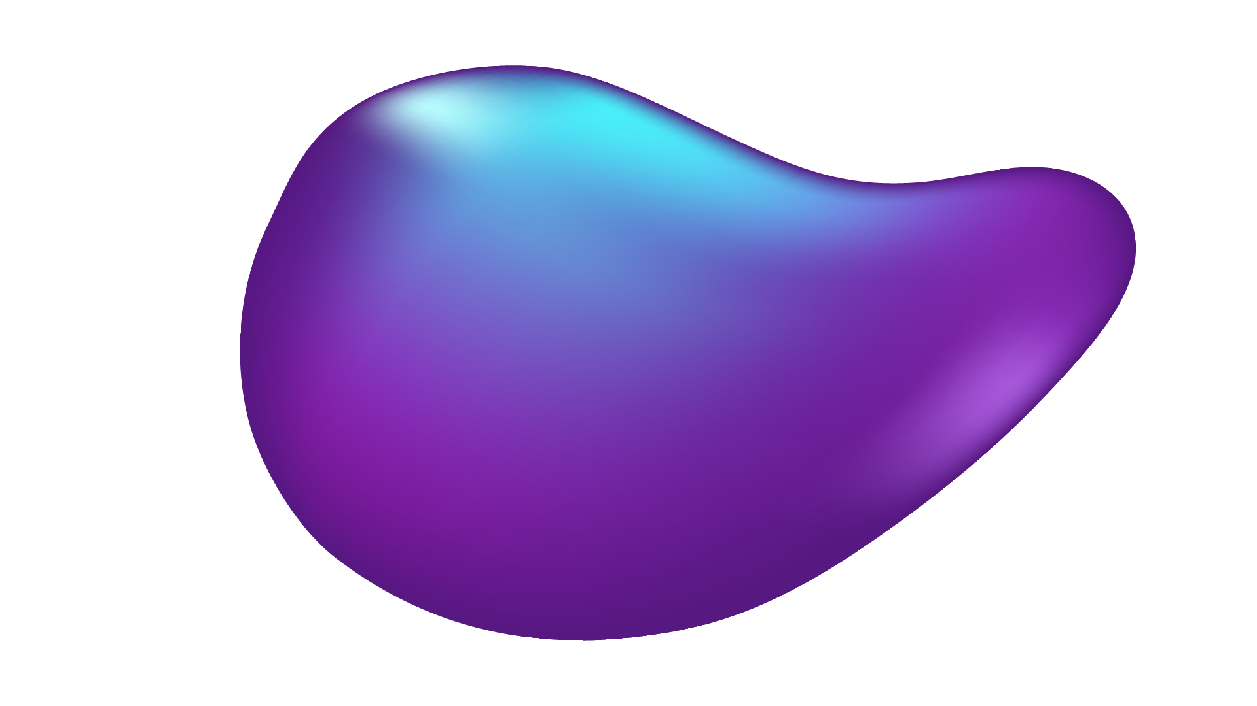
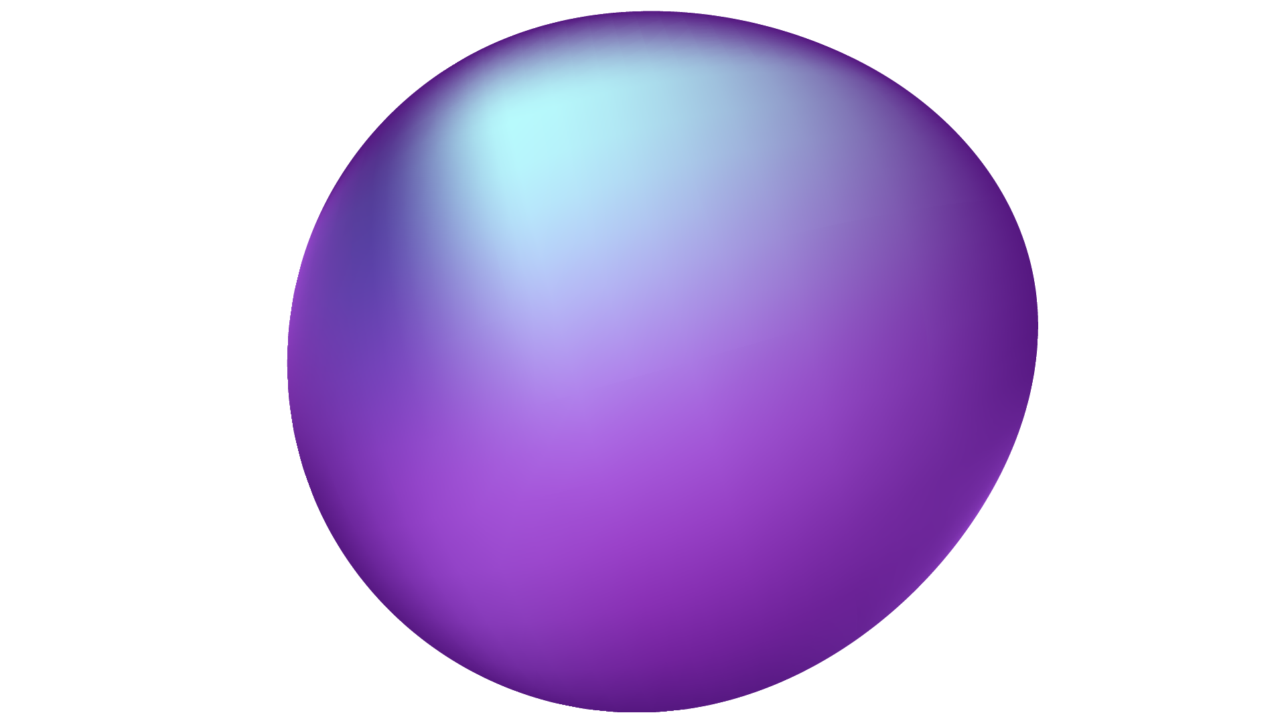
CHECKERS (AI)
PROJECT PROPOSAL
By: Ahmed Nour, Lubna Al Rifaie, and Anahita Sumoreeah

Slide 2

Overview
01
02
03
04
05
Why Checkers?
Designing The Game
Mini-Max Algorithm
Implementation
Conclusion and Resources

Slide 3
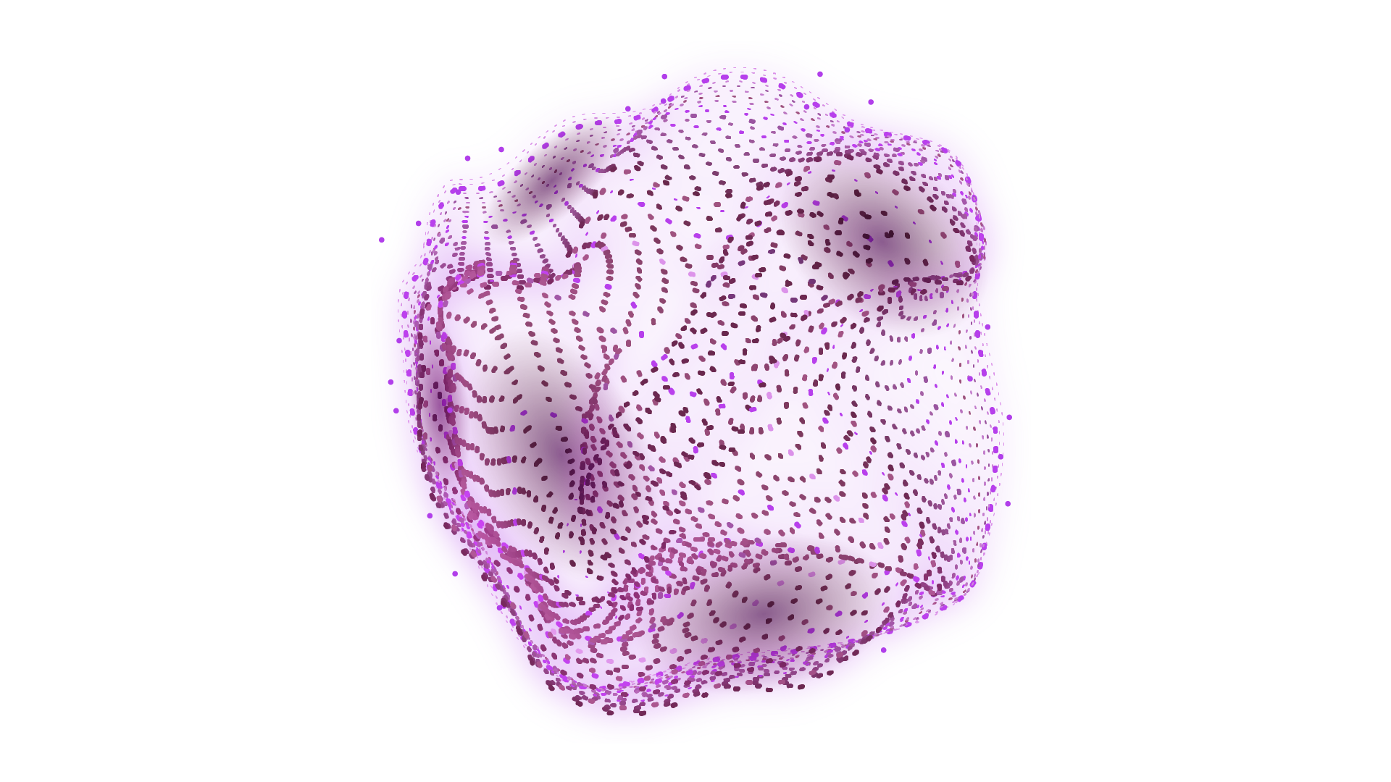
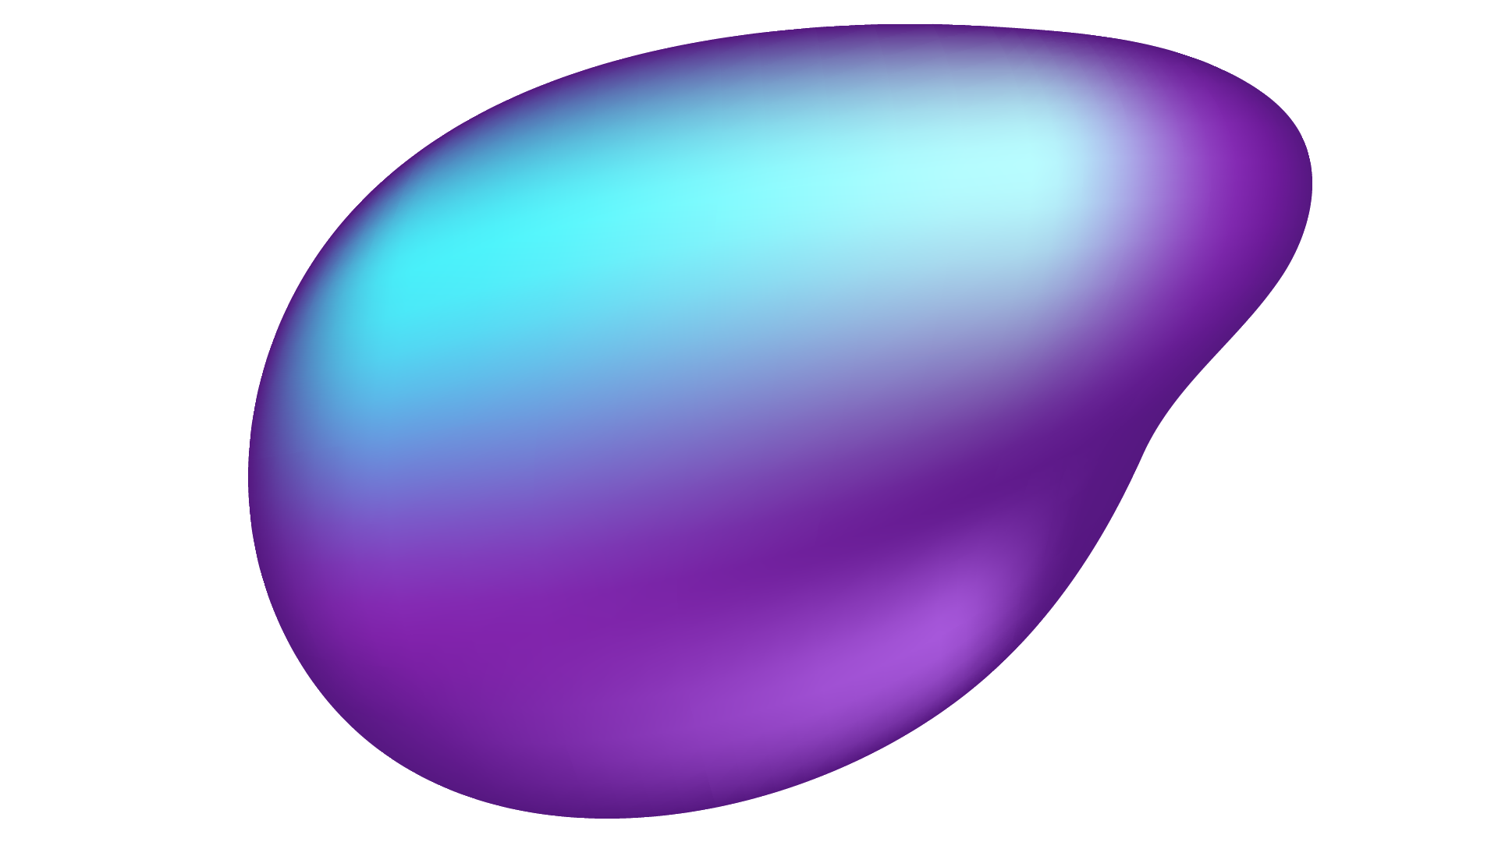
RULES OF THE GAME
One player is light, One player is dark coloured
A move consists of moving a piece forward to an adjacent unoccupied square
Double Jumps
King Piece

Slide 4
01
Why Checkers?

Slide 5
Why Checkers?
Simple rules, but deep complexity
Fundamental aspects of AI.
First ever computer to win a championship #CHAMPION

Slide 6
02
Designing The Game

Slide 7
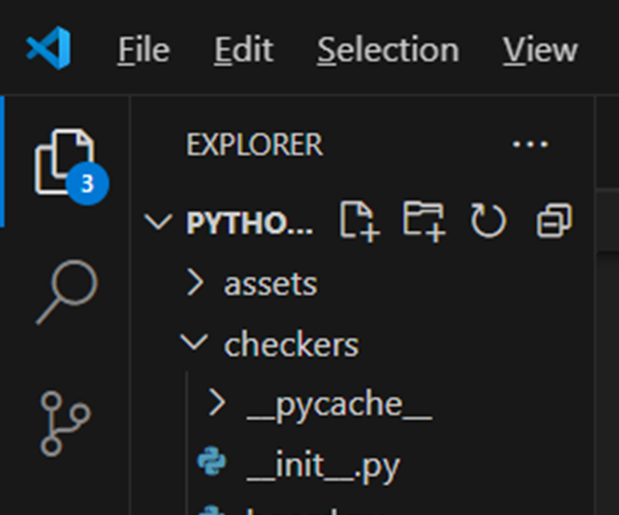
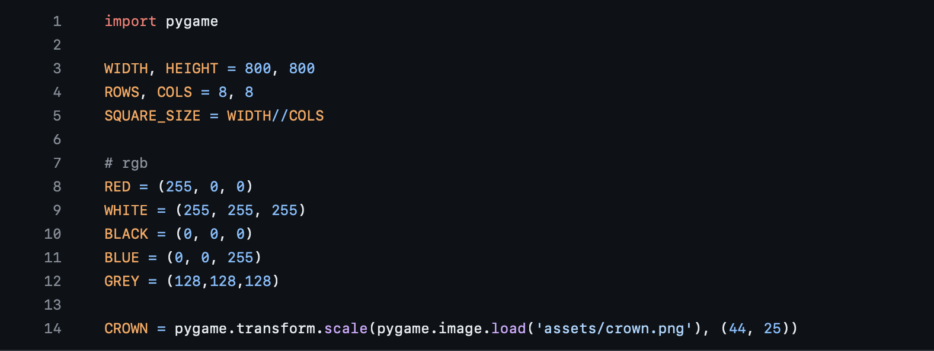
Designing the Game

Slide 8
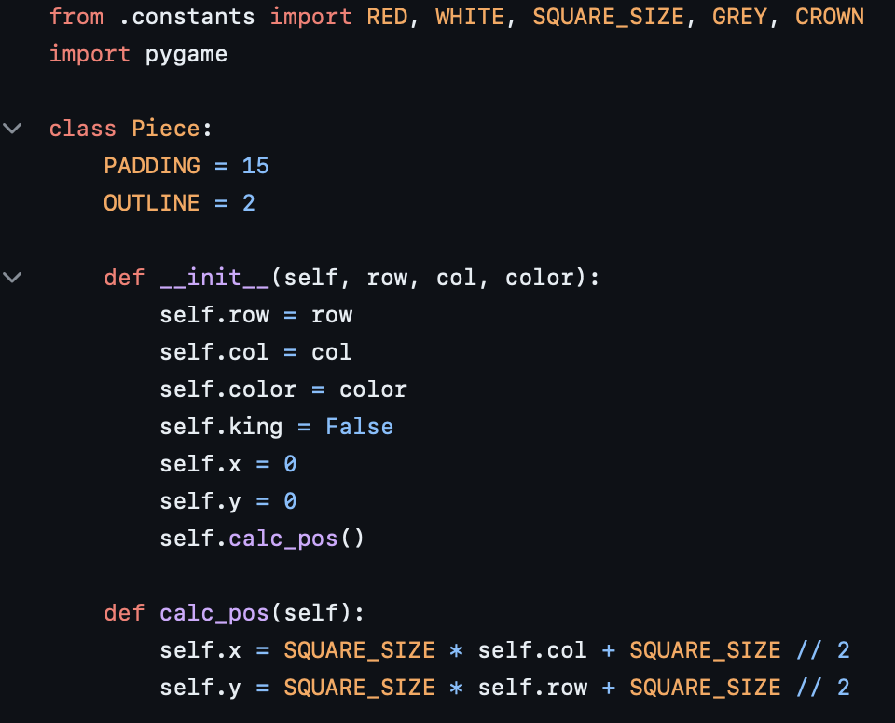
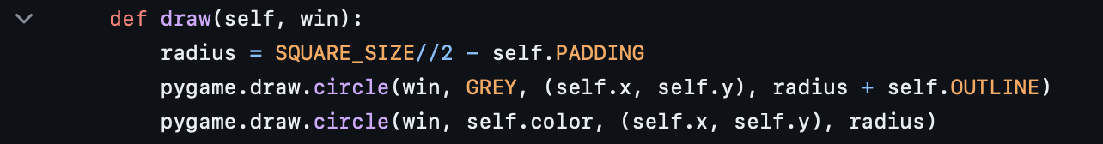
Designing The Game

Slide 9
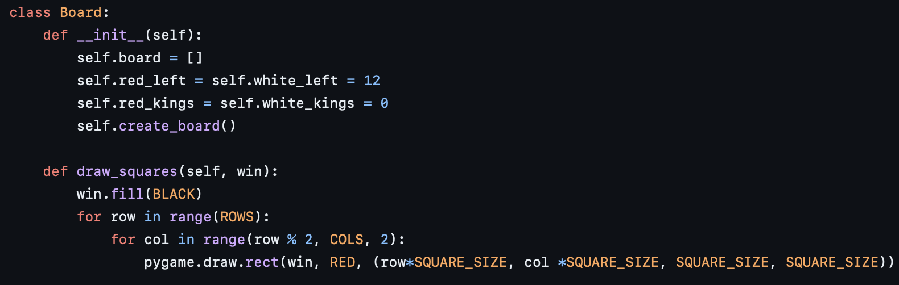
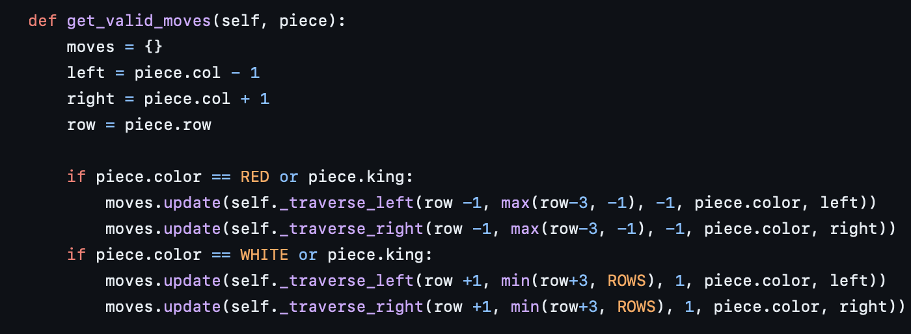
Designing The Game

Slide 10
03
Mini-Max Algorithm

Slide 11
What is Minimax?
a decision rule used to minimize the worst-case potential loss
Notes:
So What is Minimax?
Minimax is a decision-making algorithm commonly used in two-player turn-based games.
Its goal is to determine the optimal move for a player, assuming the opponent plays optimally as well.
It works by recursively evaluating possible future game states and choosing the move that maximizes the player's chances of winning while minimizing the opponent's chances.

Slide 12
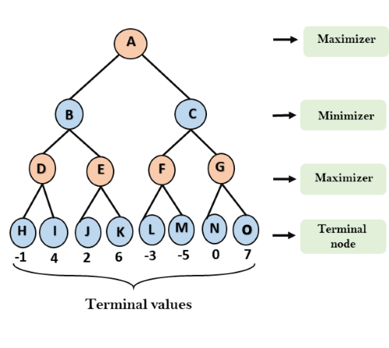
Minimax Algorithm Decision Tree
Notes:
As you can see on the screen, we have a Decision Tree representing the Minimax algorithm decision-making process.
At the root of the tree, we have the current game state, representing the initial board position.
Each node in the tree represents a possible move that the current player can make.
The tree branches out as the algorithm explores different possible moves and their consequences.
At the leaf nodes, we have the terminal states of the game, where either a player wins, loses, or the game ends in a draw.
The Minimax algorithm aims to find the best move for the current player, assuming the opponent plays optimally as well.
It works by recursively evaluating possible future game states and selecting the move that maximizes the player's chances of winning while minimizing the opponent's.
Traversal of the Decision Tree:
Starting from the root node, the algorithm traverses the Decision Tree in a depth-first manner.
At each level of the tree, the algorithm alternates between maximizing and minimizing players.
Maximizing players seek to maximize the evaluation function value, while minimizing players seek to minimize it.
Evaluation Function:
At the leaf nodes, the algorithm evaluates the current board state using an evaluation function.
This function assigns a numerical value to the board state, representing its desirability for the player.
The algorithm backtracks from the leaf nodes, propagating the evaluation values up the tree.
Selection of Best Move:
Once the entire tree is traversed, the algorithm selects the move that leads to the highest evaluation value for the maximizing player.
This selected move represents the best possible move for the current player given the current game state.

Slide 13
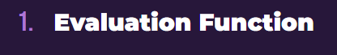
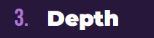
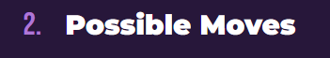
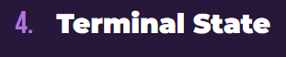
Key Components of Minimax
Notes:
Evaluation Function: In our code, the position.evaluate() function is responsible for determining the value of a given board state. Although the exact implementation of this function is not shown, it likely evaluates the current board state based on factors such as the number of pieces for each player, which aligns with the concept described in the slide.
Possible Moves: get_all_moves() function identifies all legal moves that a player can make from a given board state. This function generates and returns a list of all possible future board states resulting from legal moves by a player. This aligns perfectly with the concept described in the slide.
Depth: The depth parameter in minimax() function represents how many moves ahead the algorithm looks. It controls the depth of the search tree and determines the horizon of the search. By recursively calling the minimax() function with decreasing depth, the algorithm explores deeper into the game tree to evaluate potential future states.
Terminal State: The code checks for a terminal state in the minimax() function's base case. If the depth reaches zero or if there is a winner determined by the position.winner() function, the algorithm stops recursion and returns the evaluation of the current board state. This accurately reflects the concept of a terminal state in the Minimax algorithm, indicating when the game is over.

Slide 14
04
Implementation

Slide 15

OUR Folders
Assets Folder
Checkers Folder
Minimax Folder
Main Folder
Notes:
For our code, we have the 3 folders: assets, checkers, minimax and the file main.py. The assets folder contains resources for the game.

Slide 16
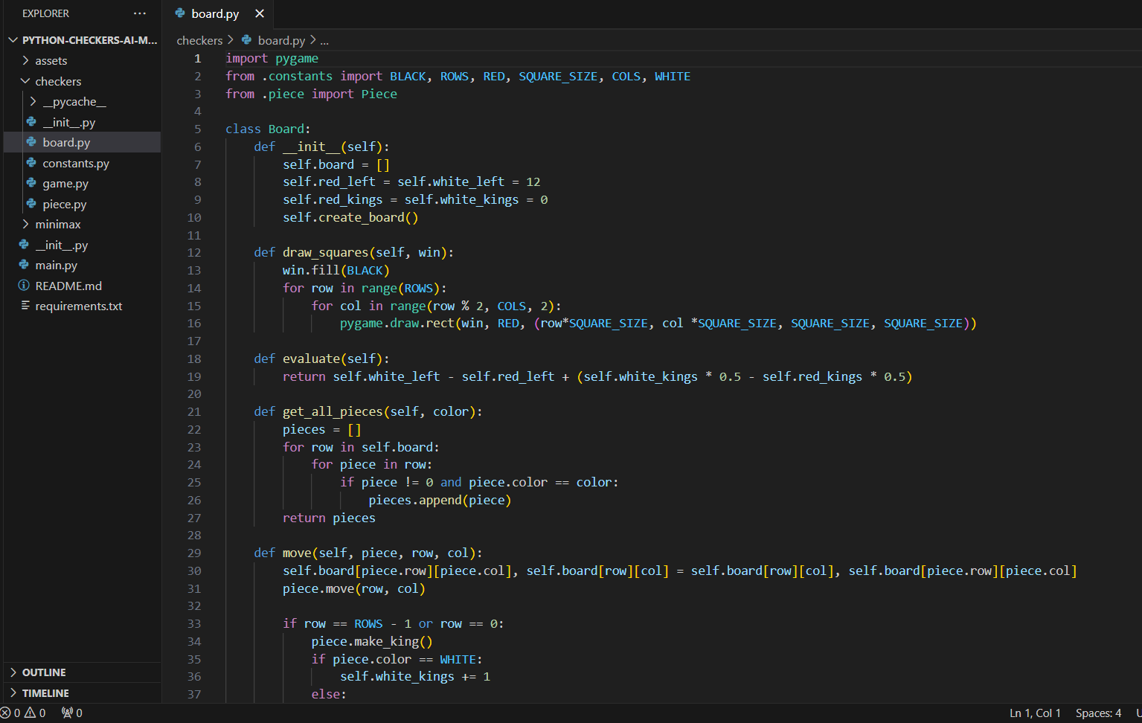
Checkers Folder
Notes:
The checkers folder contains the class board which handles the state of the actual checkers board. It will hold all of the pieces, allowing us to check what the valid moves are. We also have some stats related to how many kings and pieces are left.
Constants.py will define the constant parameters for the game
Game.py will define the rules of the game
Piece.py will define piece drawing instructions and moving rules

Slide 17
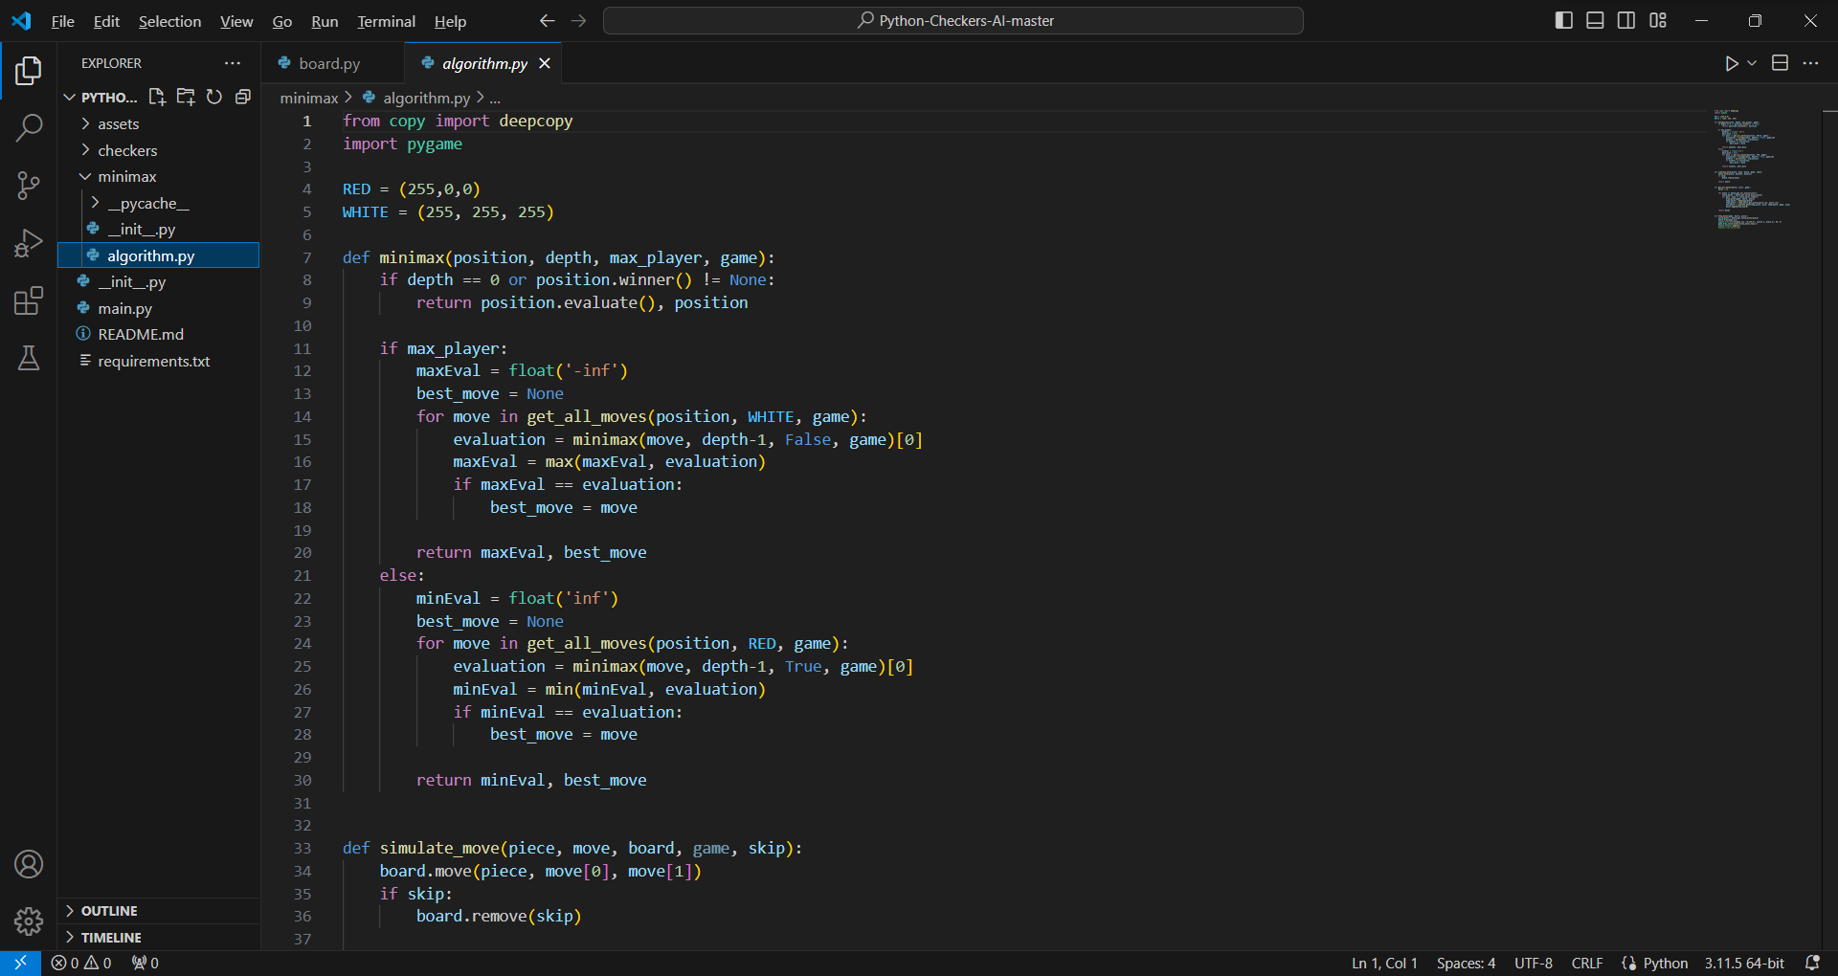
Minimax Folder
Notes:
Inside the minimax folder, there is the file algorithm.py which contains the minimax algorithm. Position is a board object. This is the current board configuration. Given the current board configuration, the minimax should provide the optimal board configuration as we play. Depth represents how far we are extending the minimax tree. Every time we evaluate the minimax algorithm, we will increase the depth by 1. Max_player is a Boolean value which selects the player. It is true if we are maximizing and false if we are minimizing the reward. Game is an object defined in main.py and is used to draw and update the board as we play.

Slide 18
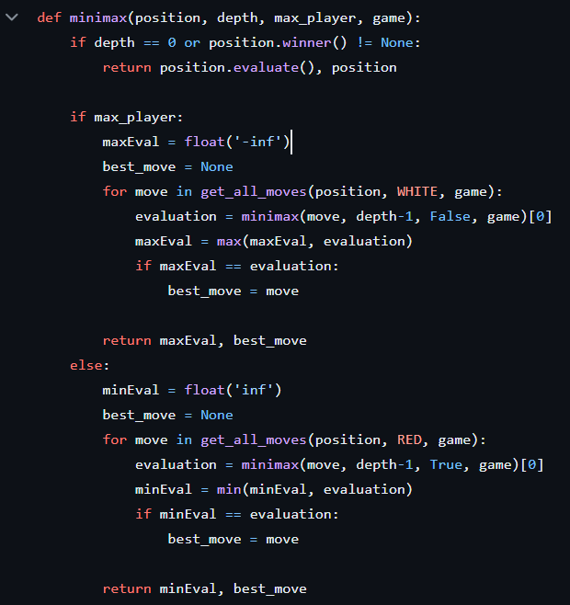
Code Implementation Overview
Notes:
Now that we've discussed the key components of the Minimax algorithm, let's take a closer look at how these concepts are implemented in our code.
In the minimax/algorithm.py file, we've implemented the Minimax algorithm along with other necessary functions for our checkers game.
Let's break down the key parts of our code:
Minimax Function: Our minimax() function is the heart of the algorithm. It recursively evaluates possible future game states to determine the best move for the current player. This function considers factors such as depth, maximizing player, and terminal states.

Slide 19
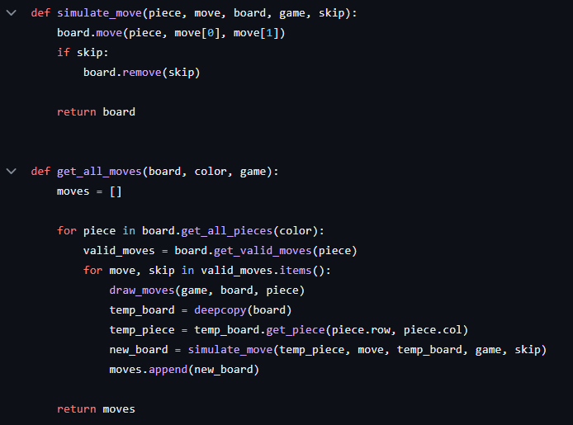
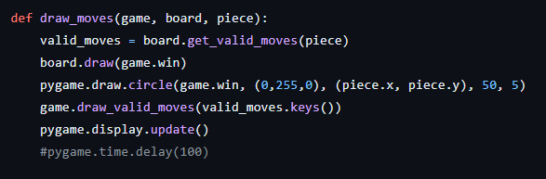
Code Implementation Overview
Notes:
Move Simulation: We have a simulate_move() function that applies a given move to a board state and returns the resulting board. This allows us to explore different potential moves and their consequences.
Get All Moves: The get_all_moves() function generates all possible legal moves for a player from a given board state. This function is essential for building the game tree and exploring possible future states.
Evaluation Function: Although not explicitly shown in this file, our code includes an evaluation function that assigns a numerical value to each board state. This function assesses the desirability of a state for the player and guides the Minimax algorithm's decision-making process.
By combining these components, our code is able to intelligently evaluate possible moves and select the one that maximizes the player's chances of winning while minimizing the opponent's.
Let's now move on to discussing how we can use this code to play a game of checkers and see the Minimax algorithm in action!

Slide 20
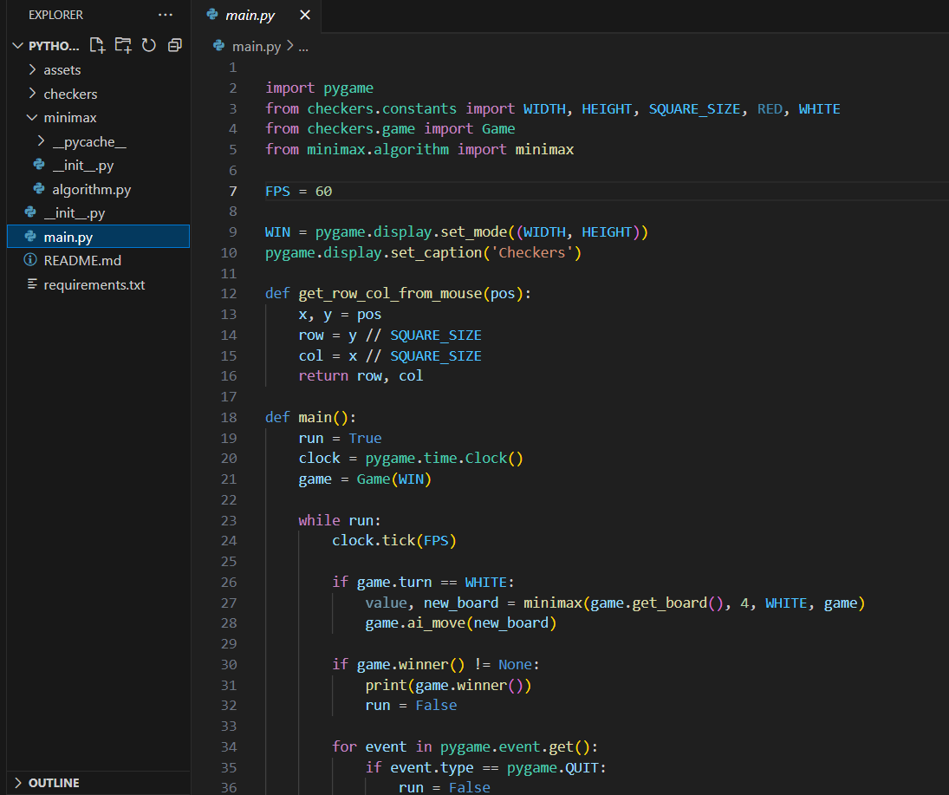
Main.py:
Notes:
The main program gets the user’s input and calls the function minimax to evaluate the best possible move. It also checks who is the winner and if someone has won the game, then we’re going to quit the game

Slide 21
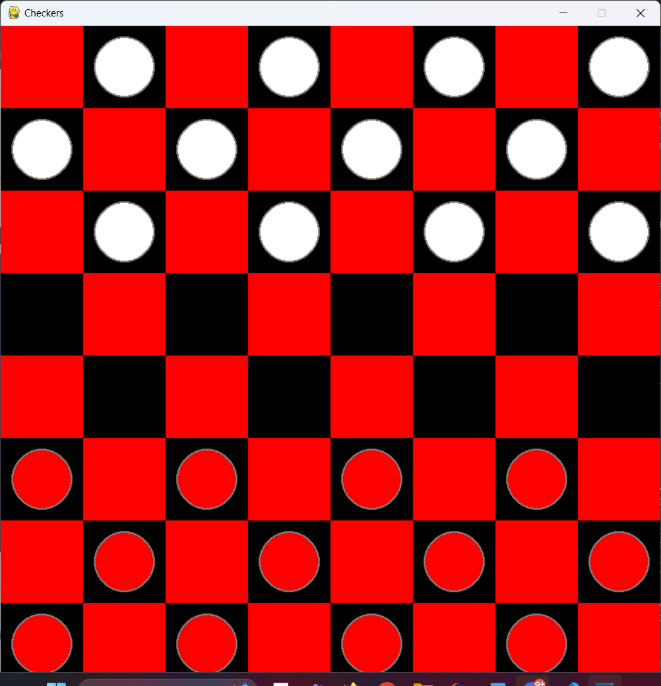
Checkers Board
White: AI
Red: Player

Slide 22
Future Improvements
When it's clear that one player has a better move available, further exploration of alternatives can be "pruned" away, saving computational time
Alpha (the best already explored option along the path for the maximizer) and beta (the best already explored option for the minimizer).

Slide 23
Live Demo

Slide 24
THANK you for listening
DO YOU HAVE ANY QUESTIONS?
Please keep this slide for attribution

Slide 25
RESOURCES
Techwithtim. (n.d.). Techwithtim/python-checkers-ai: A checkers AI using the minimax algorithm. GitHub. techwithtim/Python-Checkers-AI

